Slide 1
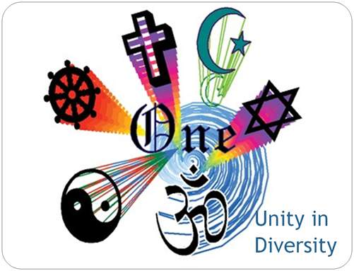
civics

Slide 2
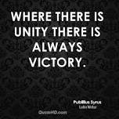
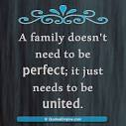
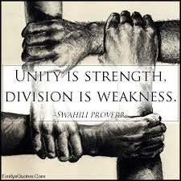
What is unity ?
the state of being united or joined as a whole.

Slide 3
What is diversity?
Simple Definition of diversity
the quality or state of having many different forms, types, ideas, etc.
the state of having people who are of different races or who have different cultures in a group or organization.
{The concept of diversity encompasses acceptance and respect. It means understanding that each individual is unique, and recognizing our individual differences. }

Slide 4
What is unity in diversity?
In the most simple terms -
the state of being united or joined as a whole even though there is difference or diversity in festivals, food habits, way of dressing, language, worship, way of getting married etc.

Slide 5
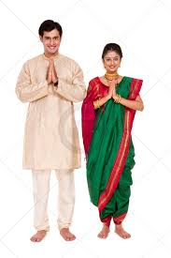
Unity – different dresses maharashtra

Slide 6
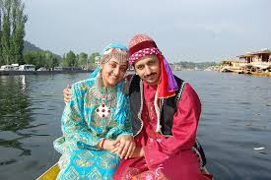
kashmir

Slide 7
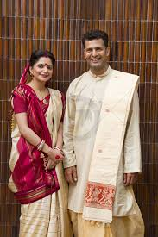
West bengal

Slide 8
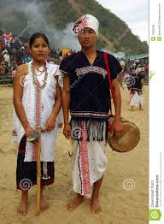
nagaland

Slide 9
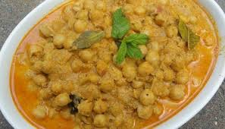
Diversity in food

Slide 10
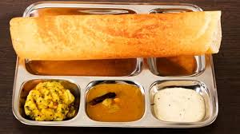
dosa- south india

Slide 11
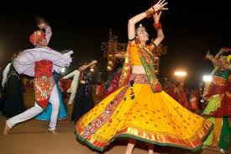
diversity in festivals- gujarat - navratri

Slide 12
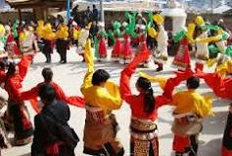
festival of kashmir- baisakhi

Slide 13
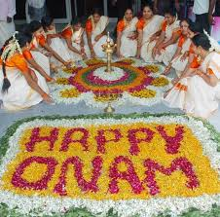
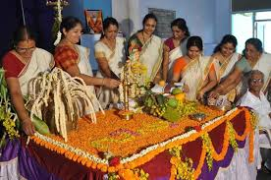
Vishu and onam in kerala

Slide 14
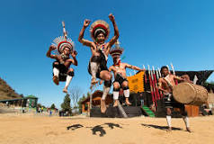
In nagaland - hornbill

Slide 15
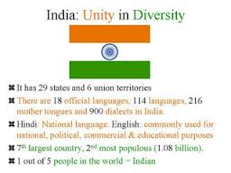
so we see that india is a country of diversity

Slide 16
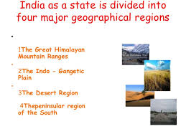
geographical diversity

Slide 17
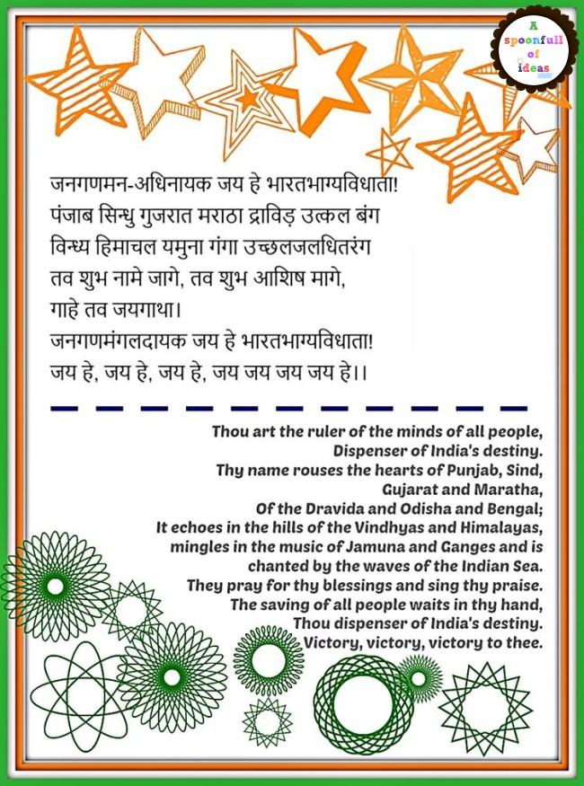
national anthem of india

Slide 18
issue-based question
In what way does our national anthem speak of ‘unity in diversity’?

